Slide 1
Iit type master game (by using C language)
Submitted By
Md.Ajijul Hakim Md.Atiqul Islam
Exam roll-180268 Exam roll-180271
Sudipto Shahnawaz Md.Hasanul Kabir
Exam roll-180269 Exam roll-180272
Moinul Islam Laskar Mozadded-ul-Islam
Exam roll-180270 Exam roll-180273

Slide 2

Supervised By
Risala Tasin Khan
Associate Professor
Institute of Information Technology
Jahangirnagar University
Savar, Dhaka-1342, Bangladesh
Institute of Information Technology
Jahangirnagar University
26th September, 2018

Slide 3
introduction
This game is named “IIT TYPEMASTER”, in this game one has to type exact words shown in the screen to gain points.
This game can be very effective to improve keyboarding and spelling skills, specially for kids.
As kids love to play ,This game will help them to learn the proper spelling as well as will make sure sporting environment.

Slide 4
Iit type master
IIT TYPE MASTER is a typing related game which offers a user to increase his typing accuracy and speed.
In this game some words of varying length are shown in the screen & the users have to type it correctly as early as possible.
There are 5 levels in the game and each level contains 5 words.
After completing each level , current score will be shown and next level will start.

Slide 5
Iit type master
If the user type any wrong word, then remaining levels with the current one will be terminated, his final score will be shown.
If any user complete all the levels, the user will be considered as a winner and his final score will be shown.
When the final score is shown, the game will be over and the game will restart.

Slide 6
Algorithm
Step 1: Start
Step 2: Enter your choice
1.New game
2.Exit
Step 3: Read choice
Step 4: If (choice==1),proceed to next step
Else go to step 15
Step 5: Set i=0,j=0 and point=0
Step 6: If (i<5) ,proceed to next step
Else go to step 12
Step 7: Print level i+1 &
Print Enter the following words…..
Step 8: Print array[i][j]

Slide 7
Algorithm
Step 9: Read input from the user
Step 10: (Both words are same)?
Yes: point=point + word length &
Do j++;
No : Go to step 13
Step 11: (j<5)?
Yes: Go to step 8
No : Print level i+1 complete!!! &
Do i++ & go to step 6
Step 12: Print WINNER!!! &
Print the score
Step 13: Print GAME OVER
Step 14: Go to step 2
Step 15: End

Slide 8
FLOWCHART
START
Enter your choice:
1. Play Game 2.EXIT
2
Input choice
1
int i=0, j=0,point=0
END
Print "Level i+1”
Print” array[i][j]
Input word
Both word matched?
Print "GAME OVER”
Print "LEVEL i+1 FAILED”
Print Point;”
NO
YES
Point+=word length
j++;
Print "WINNER” print” point”
NO
i<5?
Print "Level
i+1 complete”
NO
J<5?
YES
i++;
YES

Slide 9
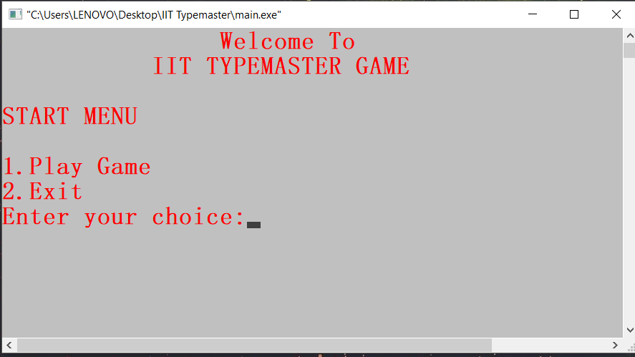
Iit TYPEMASTAER Game WHEN Starts

Slide 10
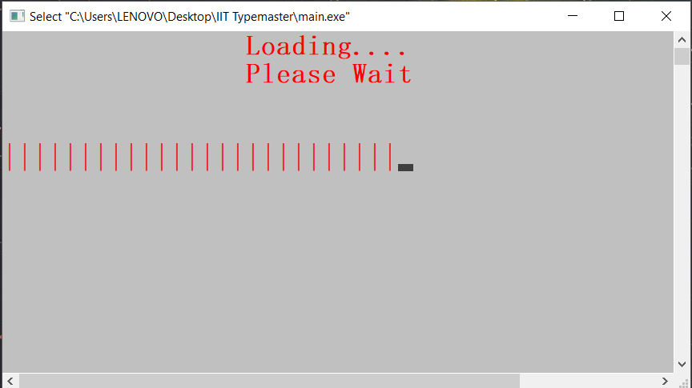
GAME IS LOADING

Slide 11
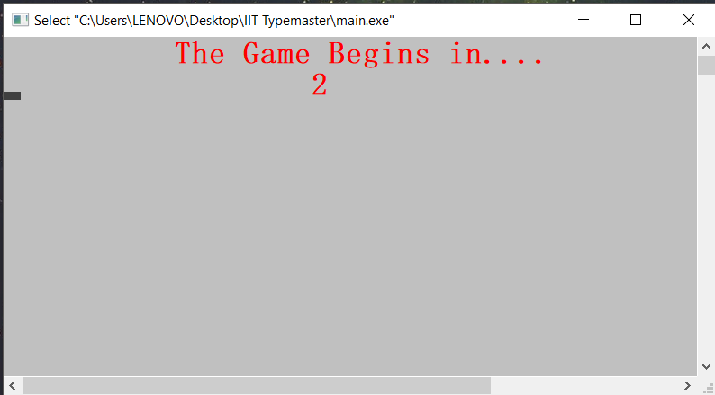
game IS BEGINNING

Slide 12
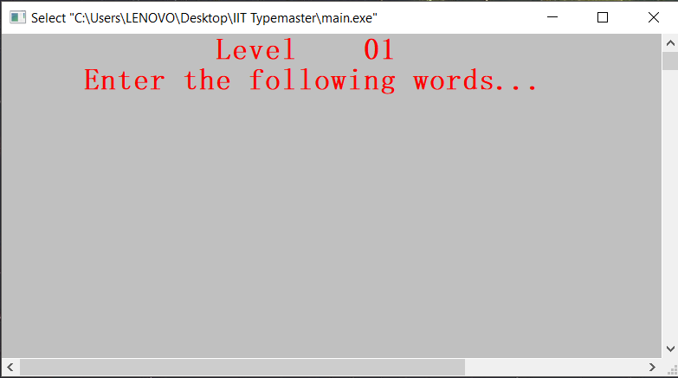
Game is showing level status

Slide 13
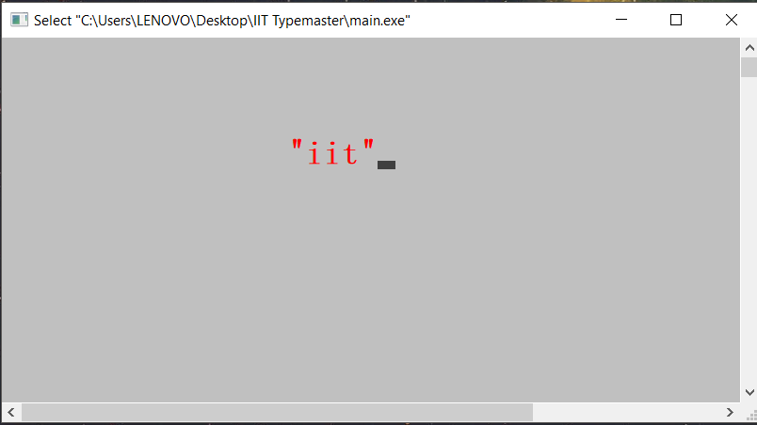
Game is showing a word

Slide 14
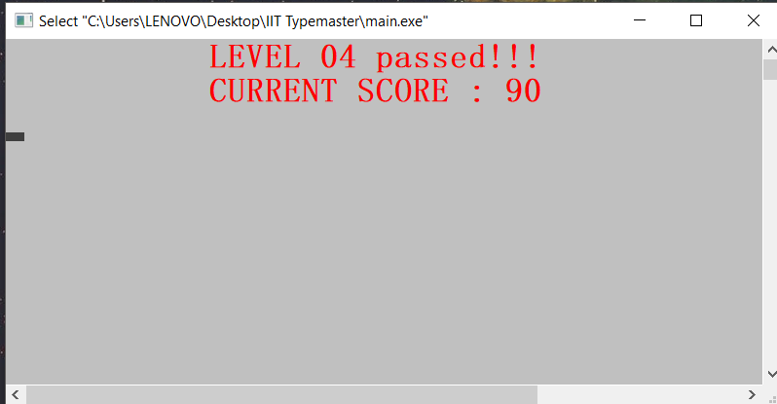
Game Status after a level completion

Slide 15
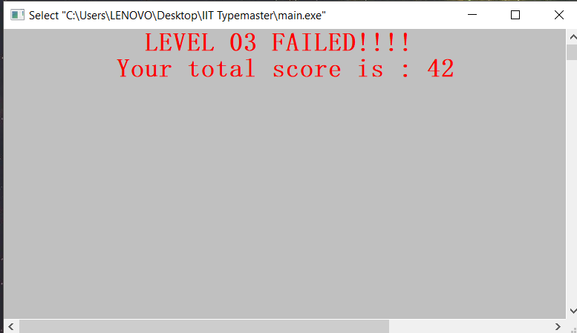
Game status when a level is failed

Slide 16
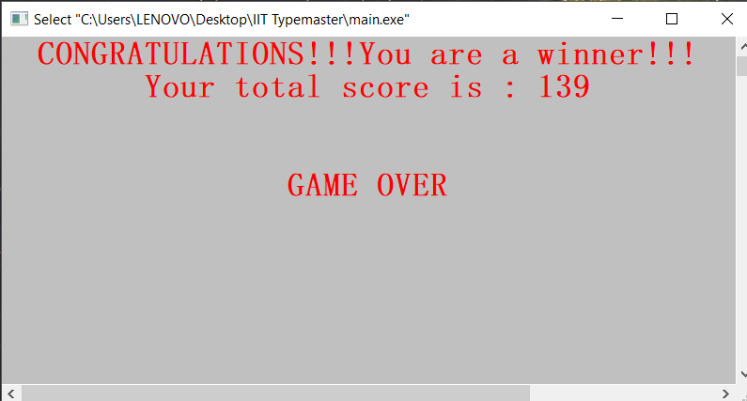
Final game status when a round is finished

Slide 17

Implements
To complete this project we have used
The C Language
Code blocks
Laptops
Algorithm of the code

Slide 18
Future GOAL
We will try to develop this game using C++ or Java language in future & make it more attractive to user.
By using graphics and sound we will try to make this game a dynamic game.
We will try to make more attractive game with new innovative ideas.

Slide 19


